Slide 1




SECONDARY SCHOOL LIBRARY MANAGEMENT SYSTEM
Submitted by: Kris Vesselee
ID: 19647
Supervised by: Dr. Bhaskar, Vidhyacharan

Slide 2
CONTENTS
Introduction
Definition and Usage of Entity Relation
Concept of ER diagrams
Conceptual Design- ER Model of Secondary School Library Management System
Implementation of Secondary School Library Management System using ER diagram
Explanation of SSLM ER diagram
Explanation of Relationship types in SSLMS
Queries
SQL Output
Relational Algebra

Slide 3

Introduction
Secondary School Record Management System is a system that stores the data of various entities in a school library.
It highlights various entities and the relationship along side the cardinality ratio that exists amongst them.
Major entities highlighted in this system are the Books, Newspapers and journal, Electronic assets, students, and teachers who sometimes borrow these items from the library.

Slide 4
Definition and Usage of ER Diagrams
What is ER Diagram?
ER diagrams are used to sketch out the design of a database. By defining the entities, their attributes and showing the relationship between them, and ER diagram illustrates the logical structure of databases. ER diagrams are created based on three basic concepts:
Entities, Attributes and Relationship.
Entity
Attributes
Relationship

Slide 5
Why Use ER Diagrams?
It helps you to define terms related to Entity relationship modeling
It provides a preview of how all the tables should connect, what fields are going to be on each table
It helps to describe entities, attributes and relationships
ER diagrams are translatable into relational tables which allow you to build databases quickly.
ER diagrams can be used by database designers as a blueprint for implementing data in specific software application.

Slide 6
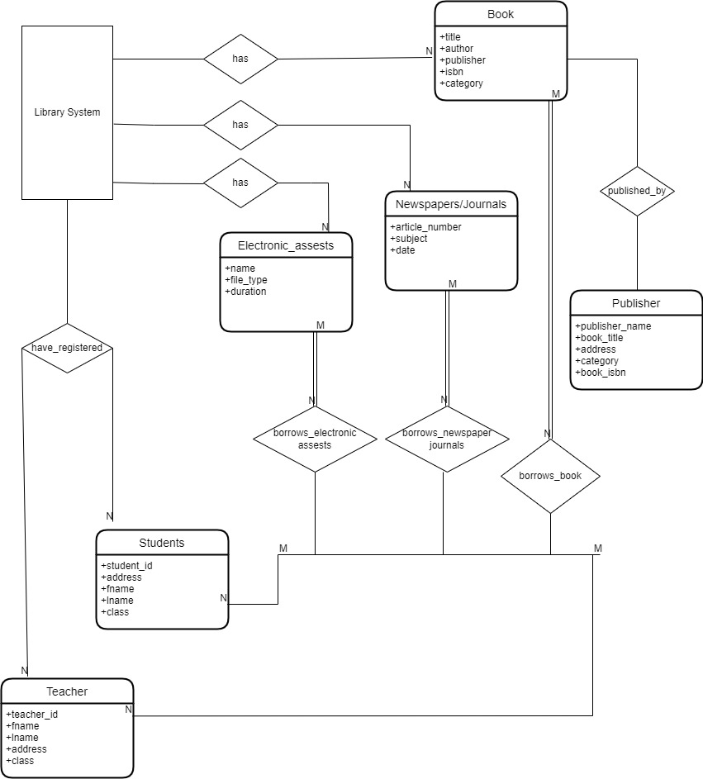
Conceptual Design

Slide 7
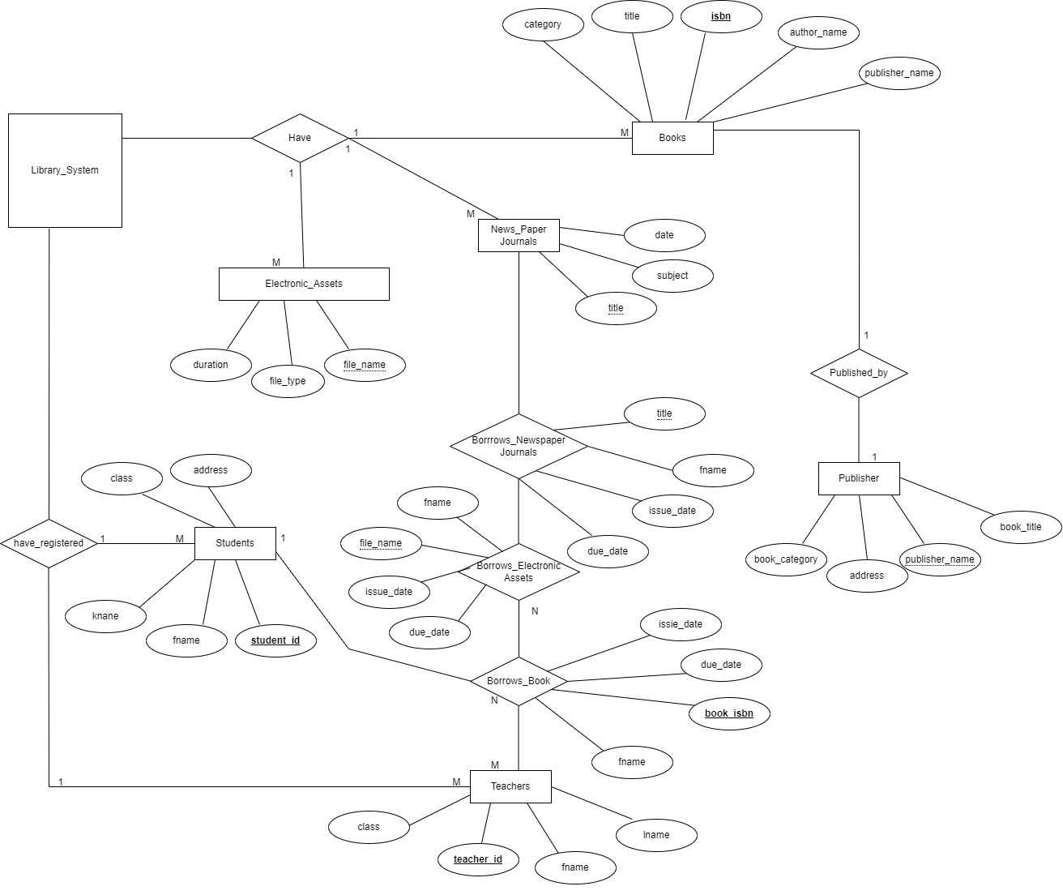
ER DIAGRAM Secondary School Library Management System

Slide 8
Secondary School ER diagram Explanation
Book-title, isbn, category, author, name, publisher
Newspaper/Journal-title, subject, date
Electronic_Assests- file_name, file_type, duration
Publisher- book_title, publisher_name, address, book_category, book_isbn
Teacher- teacher_id, fname, lname, address, class
Student- student_id, fname, lname, address, class

Slide 9
Explanation of Relationship as it relates to Secondary School Library Management System
Have- library has book, electronic assets, newspaper journal. Cardinality ratio is 1:N there can exist many different books in a library as well as different electronic assets and newspaper/ journals.
Published by- books get published by publisher. The cardinality ratio is 1:1 one book, one publisher.
Borrow_book- students, teachers borrows book from library. Cardinality ratio is M:N as many students and teachers can borrow as many books as possible.

Slide 10
Explanation of Relationship as it relates to Secondary School Library Management System
Borrow_newspaper/journal- students and teachers borrow newspaper and journals from library. Cardinality ratio is M:N as many students can borrow as many newspaper/ journals.
Borrow_Electronic_assets- students and teachers borrow newspaper and journals from library. Cardinality ratio is M:N as many students can borrow as many newspaper/ journals.
Have registered- library have registered students and teachers. Cardinality ratio is 1:N as many students and teachers can register or sign up to use the library.

Slide 11
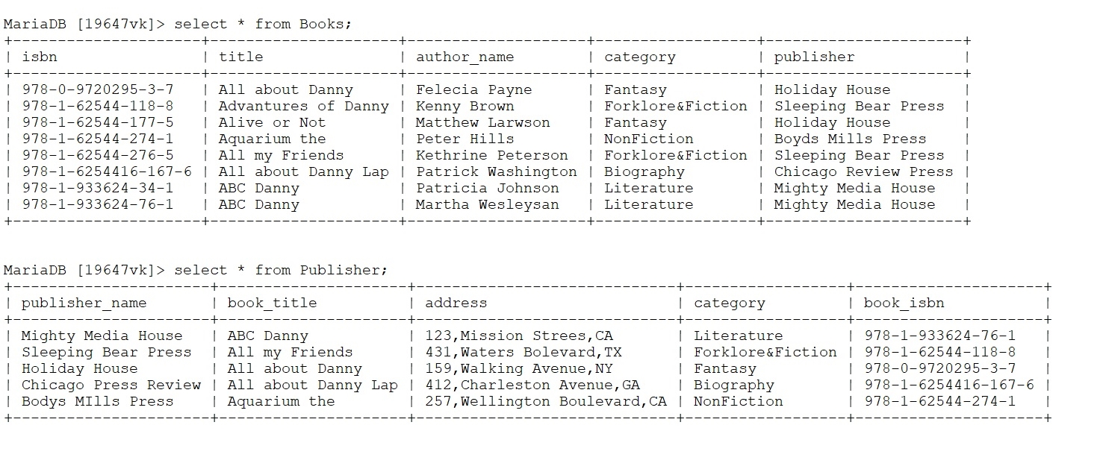
Books and Publisher Schema

Slide 12
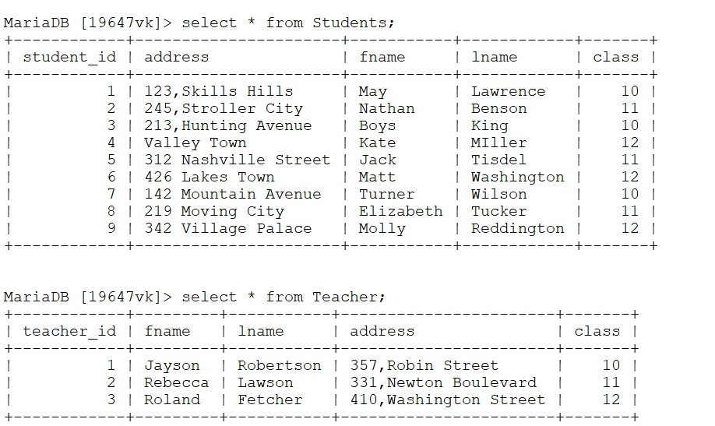
Students and Teachers Schema

Slide 13
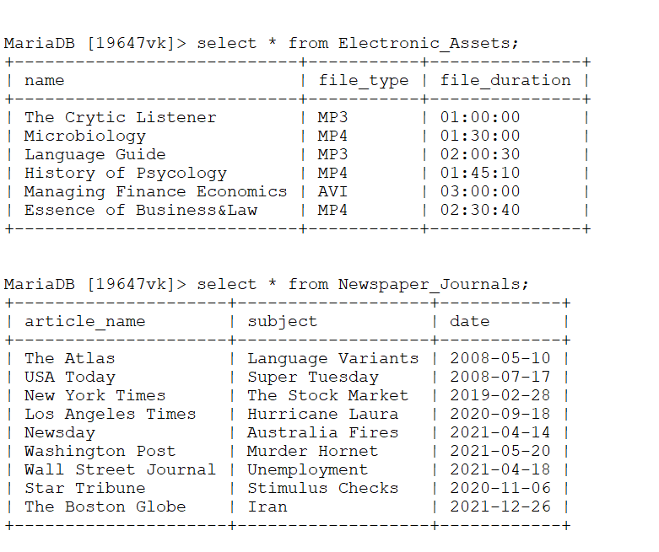
Electronic Assets, Newspaper & Journals Schema

Slide 14
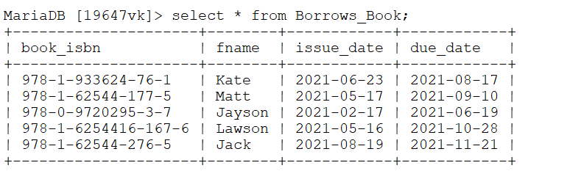
Borrows Book Schema

Slide 15
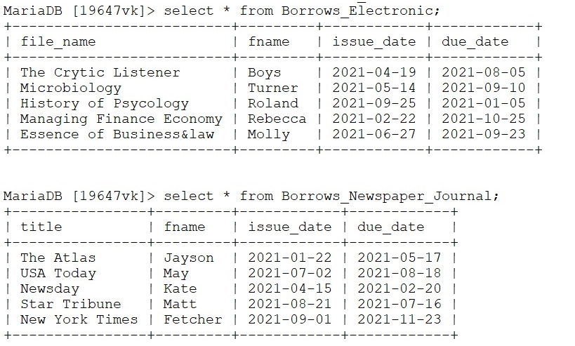
Borrows Electronic Assets ,Newspaper & Journals Schema

Slide 16
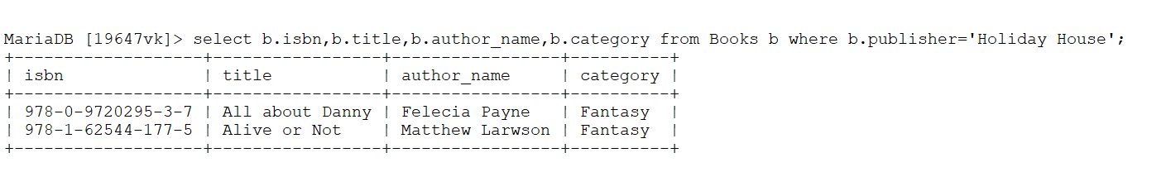

List of Some SQL Queries and Output
Q1. Select b_isbn,author_name,category from Books where publisher name is Holiday ‘House’.
Relational Algebra Expression:
HLDY_HS←σpublisher_name=‘Holiday Holiday’(Publisher)
Π isbn,title,author_name,category(HLDY_HS)

Slide 17
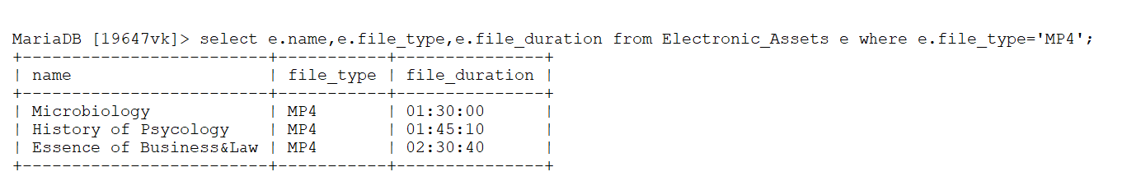
List of Some SQL Queries and Output
Q2. Select name,file type, duration from Electronis Assets where file type is ‘MP4’
Relational Algebra Expression:
MP4_FILE←σfile_type=‘MP4’(Electronic_Assets)
Π name,file type, duration(MP4_FILE)

Slide 18
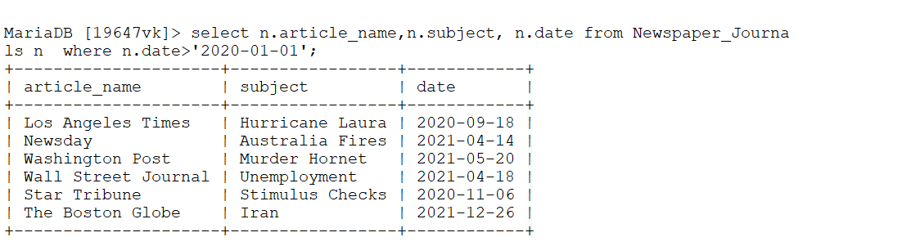
List of Some SQL Queries and Output
Q3. Select article name, subject, date from Newspaper Journals where date is greater than ‘2020-01-01
Relational Algebra Expression:
DATE←σdate>’2020-01 01’(Newspaper_Journals)
Π article_name,subject, date(DATE)

Slide 19
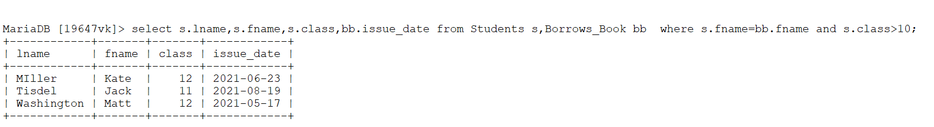
List of Some SQL Queries and Output
Q4. Select student_id, address, fname from Students where class is greater than ‘10’
Relational Algebra Expression:
CLASS_10_STUDS← σ class>10(Students)
Result←Π fname, lname, class (CLASS_10_STUDS)

Slide 20
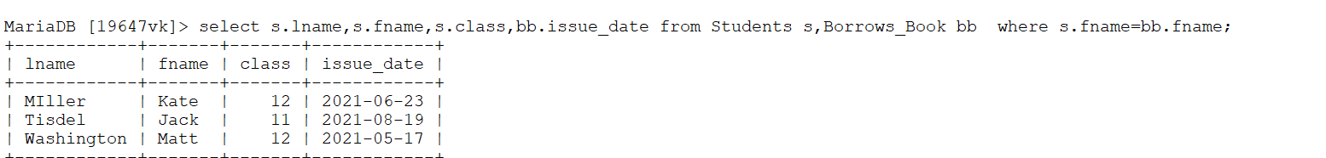
List of Some SQL Queries and Output
Q5. Select lname,fname,issue date from Students and Borrows Book table where student ‘fname’ equals Borrows book ‘fname’
Relational Algebra Expression:
CLASS_STUDS← σ fname(Students, Borrows_Book)
Result←Π fname, lname, class (CLASS_STUDS)

Slide 21
List of Some SQL Queries and Output
Q6. Select lname,fname,issue date from Teacher and Borrows Book table where teacher ‘fname’ equals Borrows book ‘fname
Relational Algebra Expression:
CLASS_TEACH← σ fname(Teachers, Borrows_Book)
Result←Π fname, lname, class (CLASS_TEACH)

Slide 22
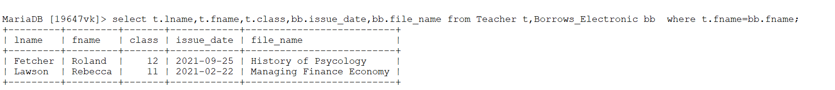
List of Some SQL Queries and Output
Q7. Select lname,fname,issue date from Teacher and Borrows Electronic Assets table where teacher ‘fname’ equals Borrows Electronic Assets ‘fname
Relational Algebra Expression:
CLASS_TEACH← σ fname(Teachers, Borrows_Electronis Assets)
Result←Π fname, lname, class (CLASS_TEACH)

Slide 23
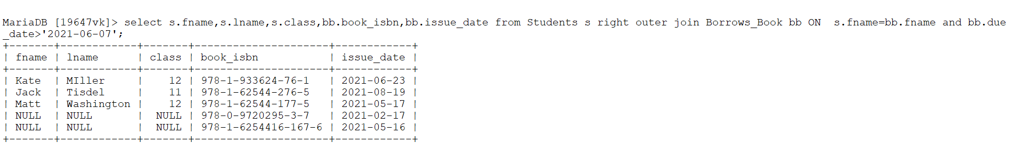
SQL Queries Right Outer Join
Q8.Select fname, lname, class, book_isbn, issue_date from Student right outer join Borrows book where student fname equals Borrows book fname and due date is greater than ‘2021-06-07’
Relational Algebra Expression:
BRR_FNAME←Student σfname=fname(Borrows_Books)
BKK_REC← σ date >’2021-06-07’(Borrows_Books)
Result← Π fname,lname,class,book_isbn,issue_date (BRR_FNAME ∪ BKK_REC )

Slide 24
SQL Queries Inner Join
Q9.Select fname, lname, class, book_isbn, issue_date from Student inner join Borrows book where student fname equals Borrows book fname and due date is greater than ‘2021-06-07’
Relational Algebra Expression:
BRR_FNAME←Student σfname=fname(Borrows_Books)
BKK_REC← σ date >’2021-06-07’(Borrows_Books)
Result← Π fname,lname,class,book_isbn,issue_date (BRR_FNAME ∪ BKK_REC )

Slide 25
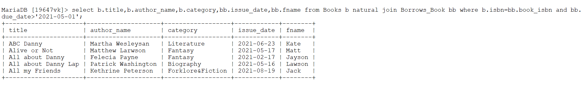
SQL Queries Natural Join
Q10.Select fname, lname, class, book_isbn, issue_date from Teacher natural join Borrows book where teacher fname equals Borrows book fname and due date is greater than ‘2021-06-07
Relational Algebra Expression:
BRR_FNAME←Teacher σfname=fname(Borrows_Books)
BKK_REC← σ date >’2021-06-07’(Borrows_Books)
Result← Π fname,lname,class,book_isbn,issue_date (BRR_FNAME ∪ BKK_REC )

Slide 26
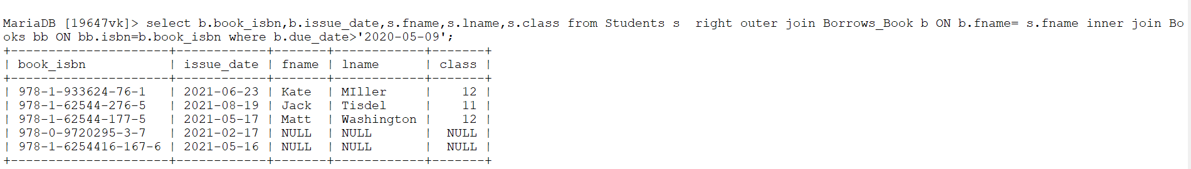
SQL Queries Three Way Join Right Outer
Q11. Select title, author name, category, issue date, fname from Books Natural join Borrows book where isbn equals book isbn and due date is greater than 2021-05-01
Relational Algebra Expression:
BRR_FNAME←Teacher σfname=fname(Borrows_Books)
BKK_N_BRRK←Borrow_Books Books σisbn=book_isbn(Borrow_Books,Books)
BRR_FNM_N_BKK_BKK←(BRR_FNAME ∪ BKK_N_BRRK)
BKK_REC← σ date >’2021-06-07’(Students)
Result← Π book_isbn,issue_date,fname,lname,class (BRR_FNM_N_BKK_BKK ∪ BKK_REC )

Slide 27
CONCLUSION
With the help of Secondary School Library Management, schools can have an organized system which showcase various major entities present in a School Library System.
It keeps records of items borrowed from the Library which include:
Students Information
Teachers Information
It is mostly students and teachers who borrows book from Library and most often, students don’t return book after borrowing it but with the help of this system, a Library can have an accurate information of all students and teachers who borrowed books from the Library and by that, it will become much easier to make follow up on them for the return of items to the Library.

Slide 28
REFERENCES
Fundamental of Database System 7th Edition. Elmasri Navathe
Allen Beaulieu Learning 2nd Edition. Allen Beaulieu

Slide 29


